Slide 1
My Favorite Place Outside
Kindergarten

Slide 2
Challenge
Create a painting showing you in your favorite place outside.

Slide 3
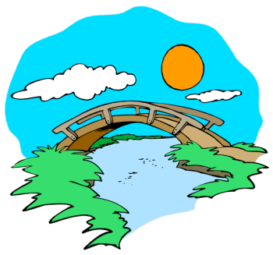


What do you see when you go outside?

Slide 4


Slide 5
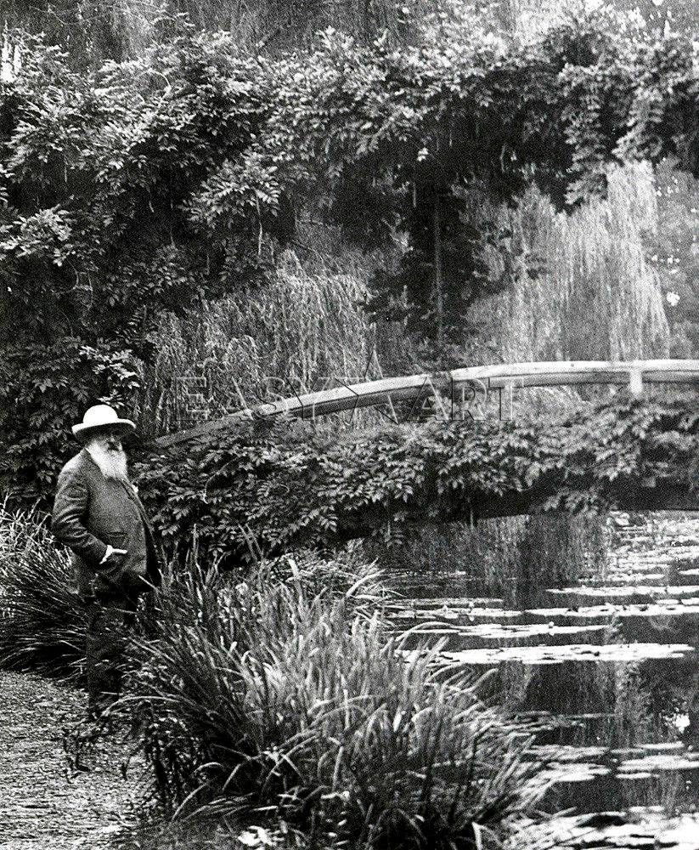
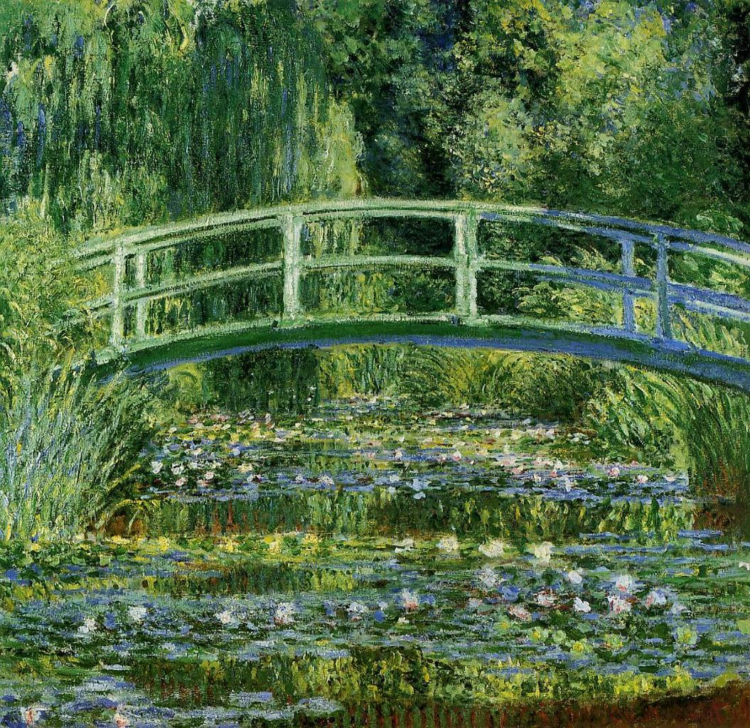
Claude Monet
What do you see?
The Japanese Bridge
By: Claude Monet

Slide 6
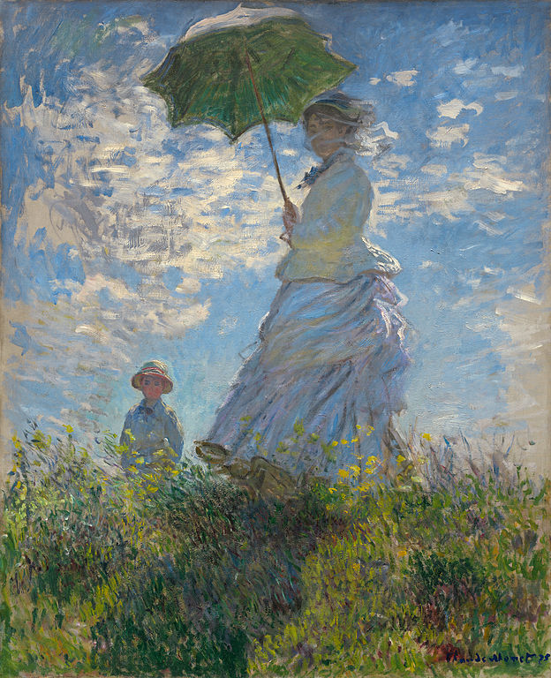
Who do you see?
Where are they?
Woman with a Parasol
By: Claude Monet

Slide 7
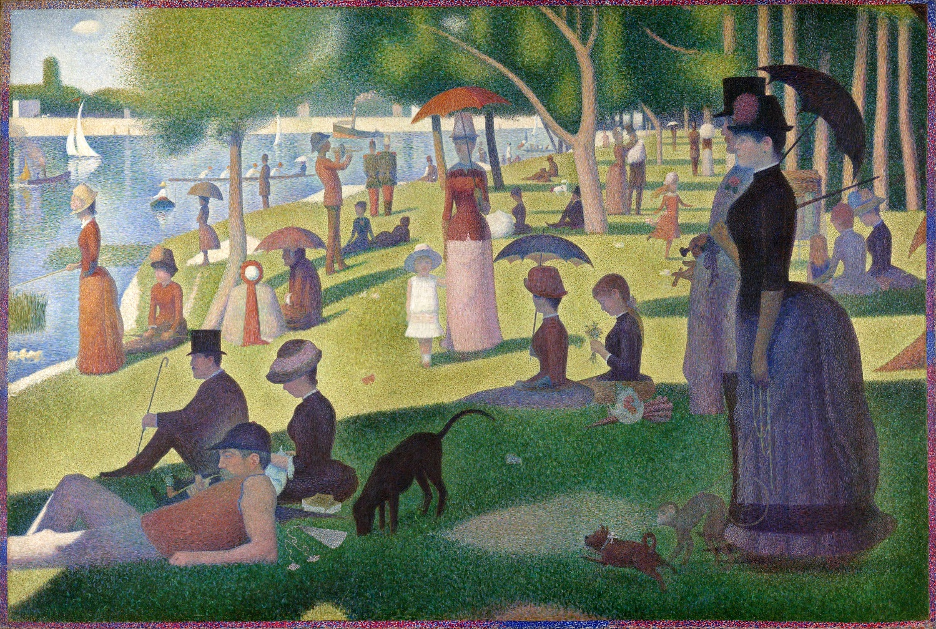
Who do you see?
Where are they?
Sunday Afternoon on La Grande Jatte
By: Georges Seurat

Slide 8
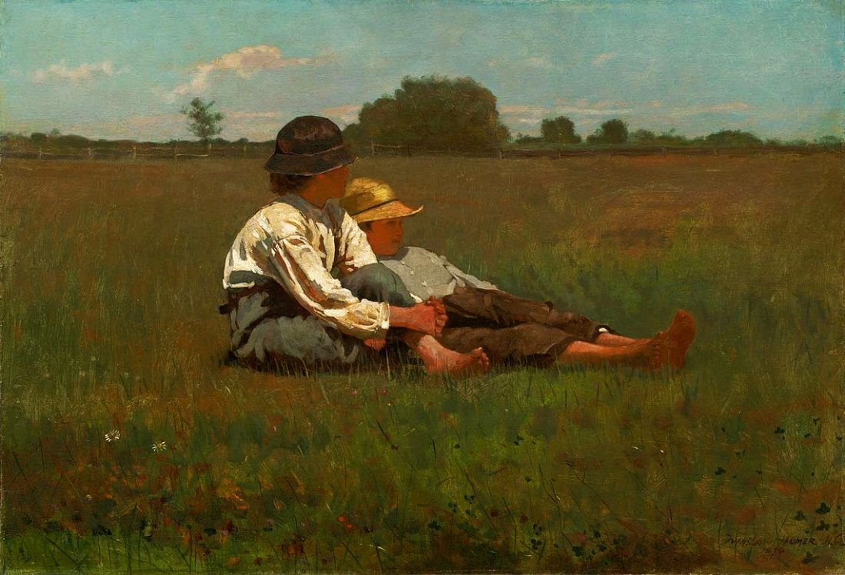
Who do you see?
Where are they?
Boys in a Pasture
By: Winslow Homer

Slide 9
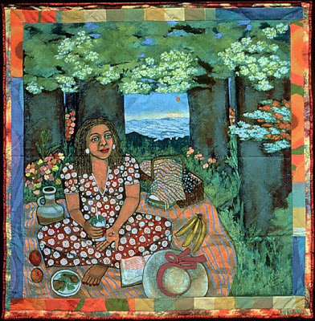
Who do you see?
Where are they?
Picnic in the Grass Alone
By: Faith Ringgold

Slide 10
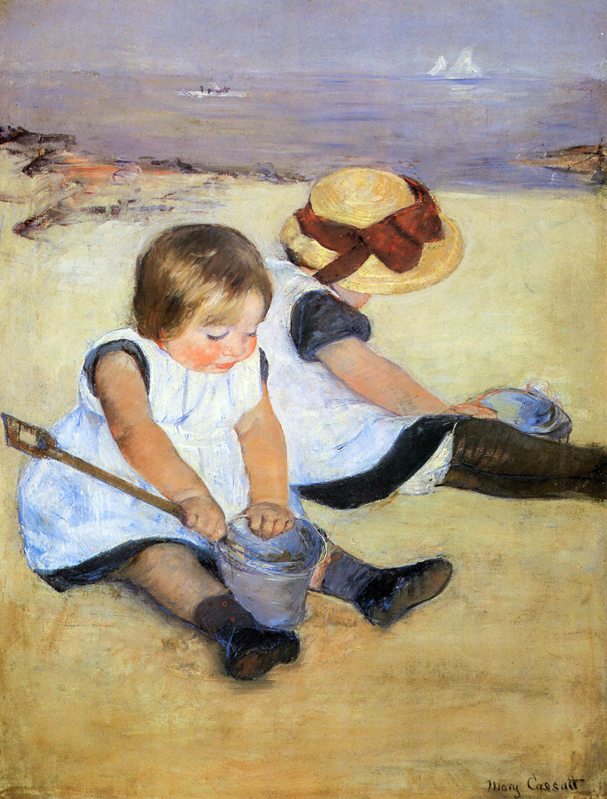
Who do you see?
Where are they?
Children Playing on the Beach
By: Mary Cassatt

Slide 11
Challenge
Create a painting showing you in your favorite place outside.

Slide 12
STEP 1: Complete Favorite Place Outside brainstorm.
STEP 2: Outline your outdoor objects with chalk.
Include at least two natural elements and a horizon line in your artwork.
Let’s Get Started

Slide 13
References
http://www.sophiewalkerstudio.com/origin-cavepavilion-sophie-walker-rhschelsea-flower-show-2014/
http://www.nga.gov/content/ngaweb/Collection/highlights/highlight74796.html
http://www.nga.gov/content/ngaweb/Collection/art-object-page.61379.html?category=The%20Collection%2CExhibitions%2CVisit%2CEducation%2CConservation%2CResearch%2CCalendar%2CAudio%2FVideo%2CAbout%2CSupport%20Us%2COpportunities%2CPress%2CNotices%2CContact%20Us%2COnline%20Features&tags=ngaweb%3Aartobjects%2F6%2F1%2F3%2F7%2F9%2FArtObject_61379&pageNumber=1&lastFacet=category
http://www.metmuseum.org/toah/works-of-art/51.112.6
http://www.winslowhomer.org/boys-in-a-pasture.jsp
http://www.faithringgold.com/ringgold/d32.htm
https://www.nga.gov/collection/gallery/ggcassattptg/ggcassattptg-52163.html

Slide 14
My Favorite Place Outside
Kindergarten
SESSION 2

Slide 15
Who remembers some natural elements you find outside?

Slide 16
Challenge
Create a painting showing you in your favorite place outside.

Slide 17

Let’s Get Started
Dip
Dab
Paint
Fill in large shapes with tempera paint.

Slide 18
My Favorite Place Outside
Kindergarten
SESSION 3

Slide 19
What do you remember about the painting process?

Slide 20
What shape is this?

Slide 21
How can we use shapes to draw ourselves?

Slide 22
STEP 1: Practice drawing yourself using shapes.
STEP 2: Use your shapes to draw yourself in your painting with crayon.
STEP 3: Overpaint and fill in your shapes with tempera paint.
Let’s Get Started

Slide 23
My Favorite Place Outside
Kindergarten
SESSION 4

Slide 24
What do you remember about the painting process?

Slide 25
STEP 1: Overpaint to add details and textures.
STEP 2: Use different brush strokes:
Short, Long, Curved and Straight.
STEP 3: Finish painting.
Let’s Get Started

Slide 26
Gallery Walk
Share with the class your painting.
What is your favorite place outside?
Share two natural elements you included in your painting.

