Slide 1
Catch of the day
5th Grade

Slide 2
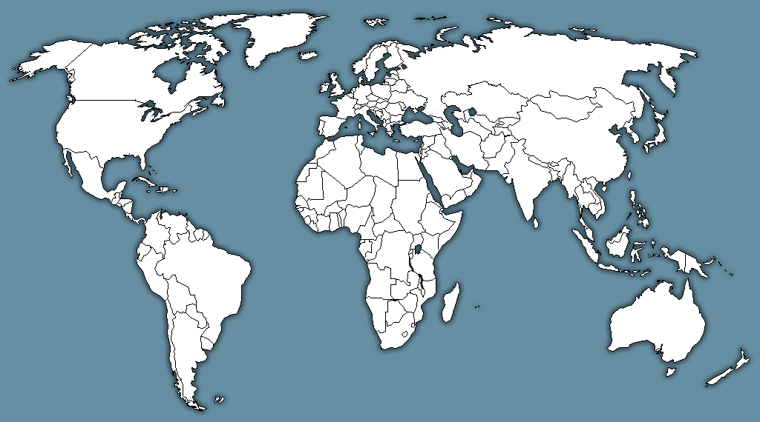
How many oceans are in the world?
ARCTIC
PACIFIC
ATLANTIC
PACIFIC
INDIAN
SOUTHERN

Slide 3
Why are oceans important?

Slide 4
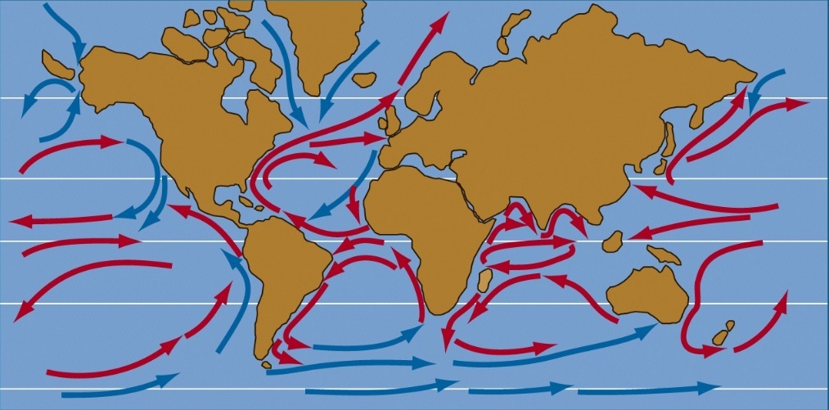
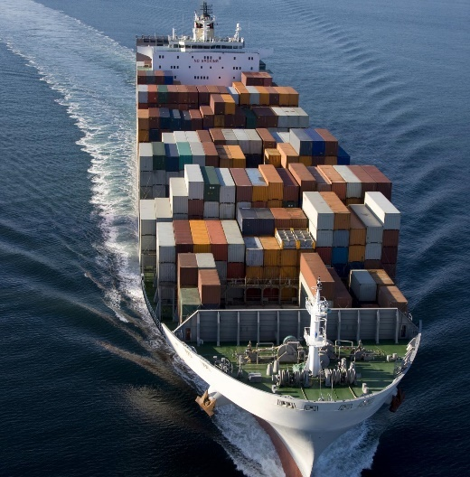
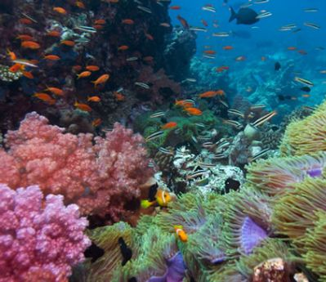
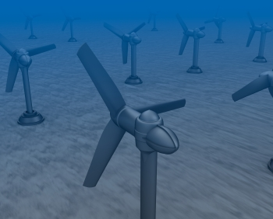
Oceans cover 70% of the earth’s surface
Social & Economic
Goods & Services
Transportation
Tourism
Recreation
Climate Regulation
Transports heat
Drives weather patterns
Living & Non-Living Resources
Food sources
Minerals
Energy

Slide 5
Why are fish important?

Slide 6
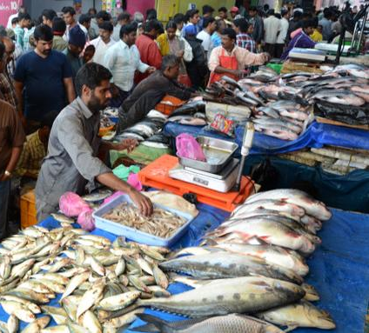
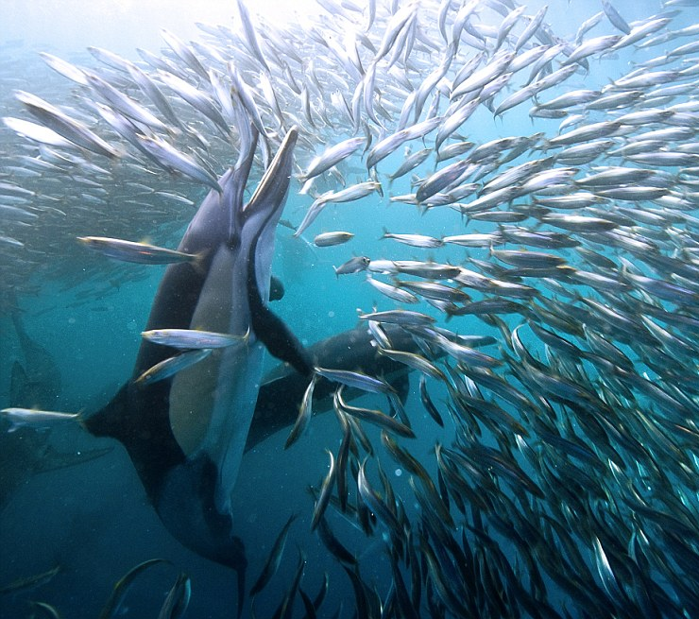
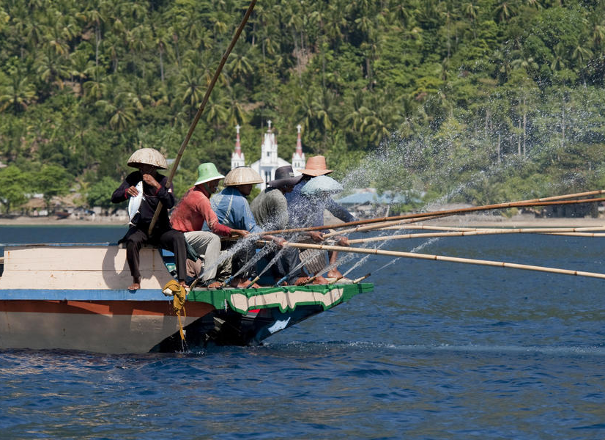
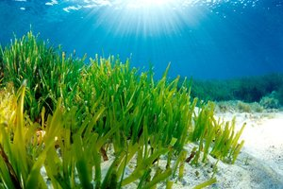
Why are fish important?
More than 30,000 different species of fish living in various ecosystems around the world.
Fish not only provide a food source for fishing communities, but they are also an important food sources for other marine communities.
Fish contribute to the growth of sea grass and algae by excreting the nutrients they take in after consuming micro organisms, plants and smaller animals.

Slide 7
Food and job sources

Slide 8
How can artists use fish as inspiration in their artwork?

Slide 9
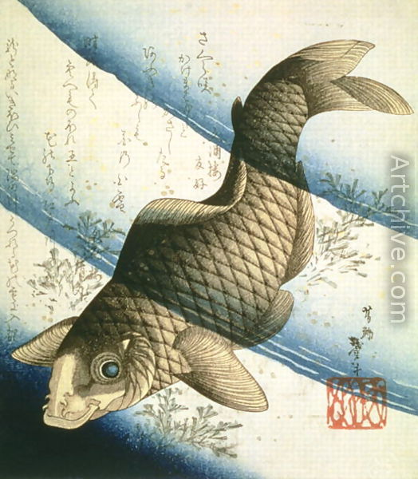
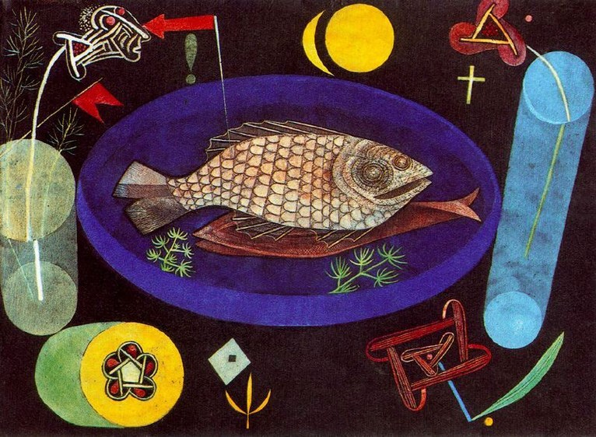
Around the Fish, Paul Klee
A Carp Swimming Among Waterweeds, Katsushika Taito II

Slide 10
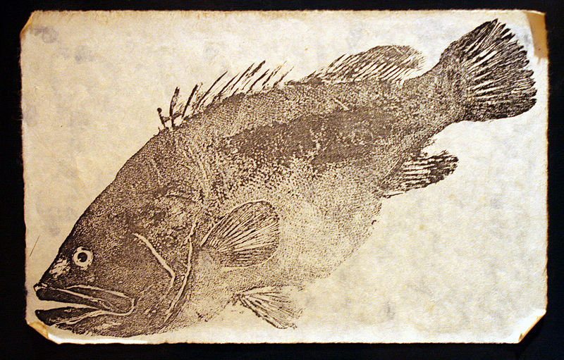

Slide 11
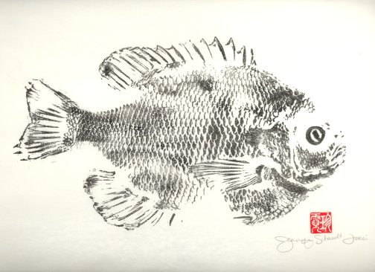
GYOTAKU
“GEE-OH-TAH-KOO”
- The Japanese art of fish printing.
- Evolved in Japan more than one hundred years ago as a means for fishermen to record and document the size of their catches.

Slide 12
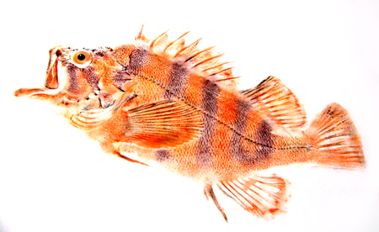
Tiger Rockfish, Chris Dewees

Slide 13
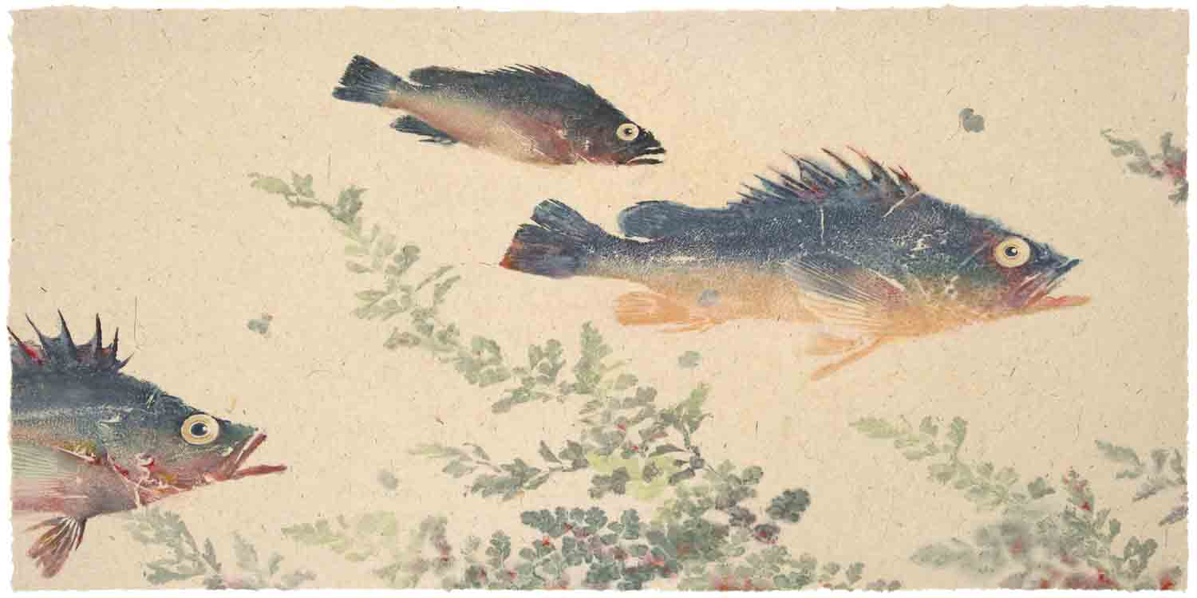
Rockfish with Maidenhair Fern, Lori Hatch

Slide 14
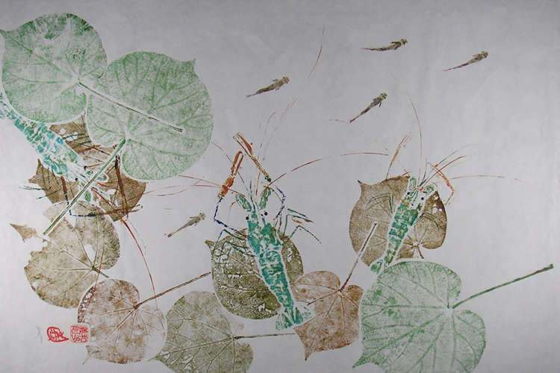
Under the Hau – Prawns, Derek Yoshinori Wada

Slide 15
GYOTAKU
“GEE-OH-TAH-KOO”
- The Japanese art of fish printing.
- Evolved in Japan more than one hundred years ago as a means for fishermen to record and document the size of their catches.
https://youtu.be/k_mG-Ka4mv8

Slide 16
What is composition?
COMPOSITION - the placement or arrangement of visual elements or ingredients in a work of art.
Tools artists can use to create composition

Slide 17
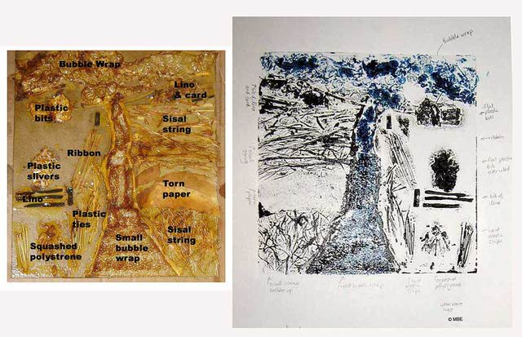
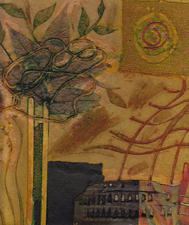
What is a collagraph print?
Collagraphy is a printmaking process in which materials are applied to a rigid substrate (such as cardboard or wood)

Slide 18
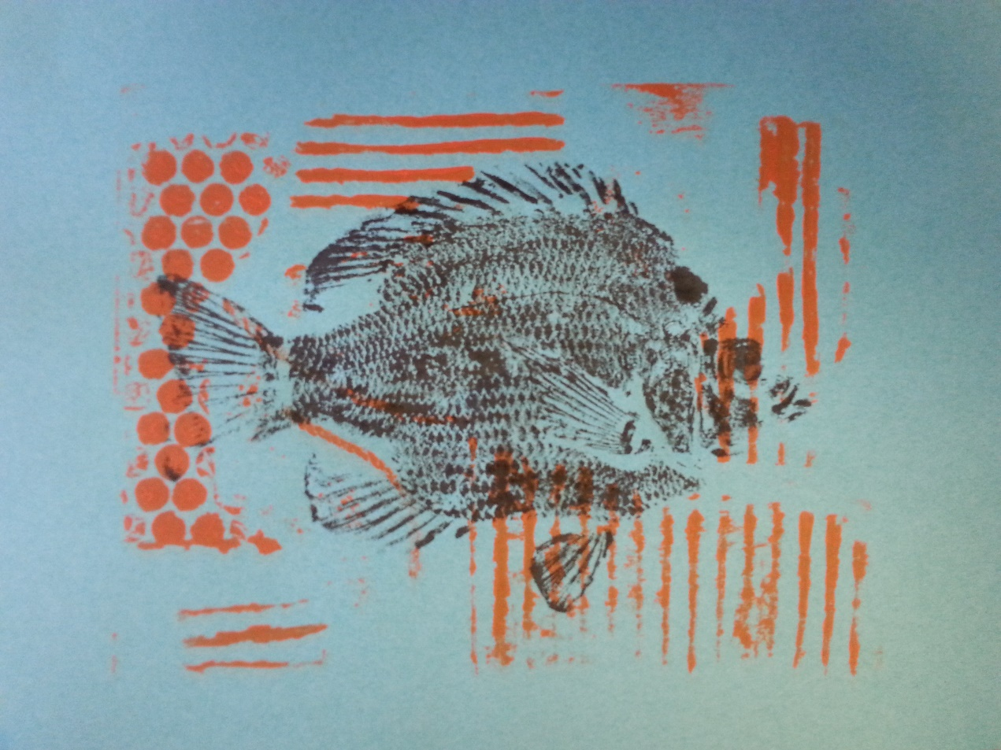
Challenge
Create gyotaku inspired prints using collagraph and monotype printing methods.

Slide 19
Catch of the day
5th Grade
Session 2

Slide 20
What is composition?
COMPOSITION - the placement or arrangement of visual elements or ingredients in a work of art.

Slide 21
What is a collagraph print?
Collagraphy is a printmaking process in which materials are applied to a rigid substrate (such as cardboard or wood)

Slide 22
Challenge
Create gyotaku inspired prints using collagraph and monotype printing methods.

Slide 23
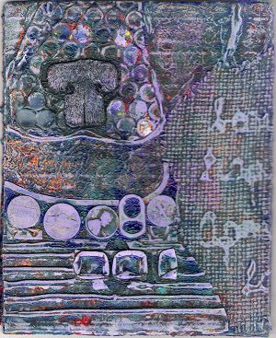
Let’s Get Started – Collagraph Printmaking
STEP 1: Select five 9x12 construction papers and one gray construction paper. Six papers total.
STEP 2: Stack your construction papers with the gray paper on TOP.
STEP 3: Print your gray paper first.
This is your Artist’s Proof.
STEP 4: Follow instructions for signing
your prints.
STEP 5: Completed and signed prints
go on the drying rack.

Slide 24
Catch of the day
5th Grade
Session 3

Slide 25
What is printmaking method did we use to create our backgrounds?
Collagraphy is a printmaking process in which materials are applied to a rigid substrate (such as cardboard or wood)

Slide 26
What is monotype printmaking?
Monotyping is a type of printmaking made by drawing or painting on a smooth, non-absorbent surface. The image is then transferred onto a sheet of paper by pressing the two together.
Monotype printmaking produces unique, one-of-a-kind prints.

Slide 27
GYOTAKU
“GEE-OH-TAH-KOO”
- The Japanese art of fish printing.
- Direct printing from fish creates unique one-of-a-kind prints, or monotypes.

Slide 28
Challenge
Create gyotaku inspired prints using collagraph and monotype printing methods.

Slide 29
Let’s Get Started – Gyotaku Printmaking
STEP 1: Practice first with rice paper.
STEP 2: Print your gray Artist’s Poof next.
Then print your remaining five prints.
STEP 3: Follow instructions for signing your prints.
STEP 4: Place each print on the
drying rack as it is finished.
STEP 5: Complete written Artist
Statement.
Use complete sentences.

Slide 30
References
http://www.lorihatch.com/page4g3.html
http://deweesnaturedesigns.com/chrisgallery.shtml
http://natureprintshawaii.com/upstream/
http://www.artchive.com/web_gallery/K/Katsushika-II-%28Hokusen%29-Taito/A-Carp-Swimming-among-Waterweeds,-c.1832.html
http://www.moma.org/collection/works/79342
http://wwf.panda.org/about_our_earth/blue_planet/problems/
http://data.oceanhealthindex.org/data-and-downloads
https://youtu.be/k_mG-Ka4mv8

